Slide 1
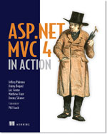




Real World Polyglot Persistence
Jimmy Bogard
@jbogard
jimmybogard.lostechies.com

Slide 2
What is NoSQL?
Not relational
Built for scale
Typically schemaless

Slide 3
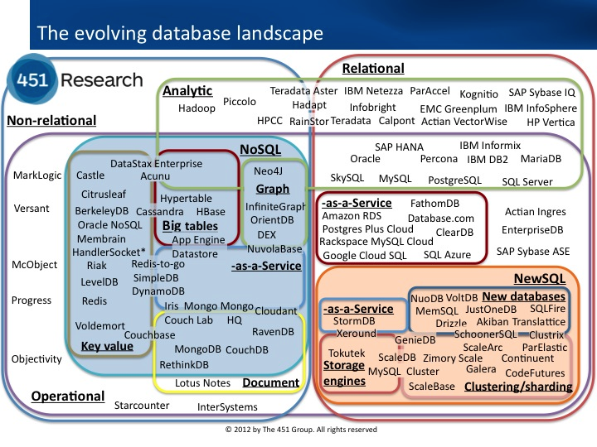
NoSQL Families

Slide 4
Relational Models

Slide 5
Key/Value Stores
[Bucket = AspNetSession]
[Key = AspNetSession/8uhwe9fjs93]
[Value = RedisSessionState]

Slide 6
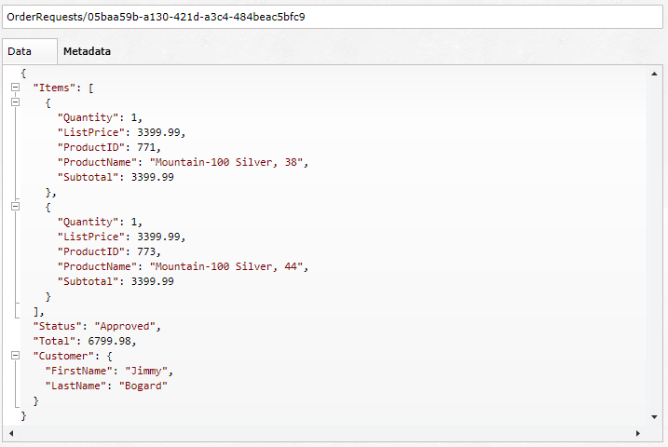
Document Database

Slide 7
Graph Database
ProductId:23
ProductId:24
ProductId:771
ProductId:989
ProductId:65

Slide 8
Challenges
Notes:
FUD, expertise, support

Slide 9
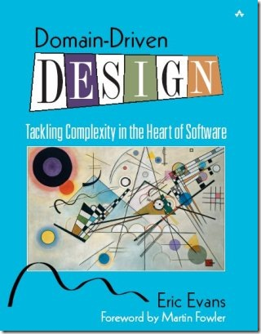
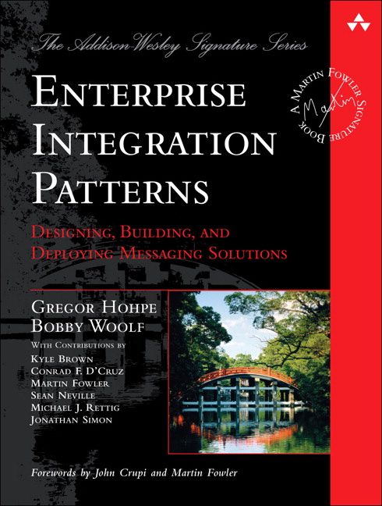
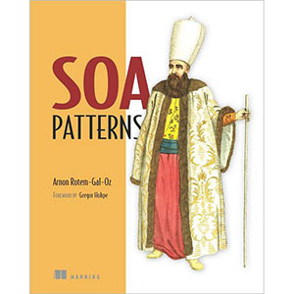
Putting it together

Slide 10
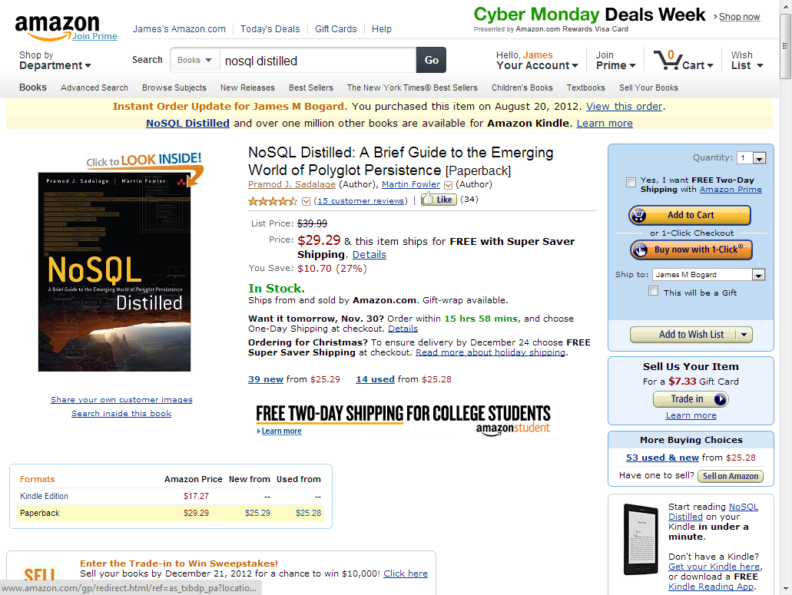
Amazon example

Slide 11
Flipping N-Tier
UI
BL
DAL
DB

Slide 12
Composition Techniques
Infrastructure
Web APIs
Messaging
UI - Browser
UI - Serve

Slide 13
Sample App

